Slide 1
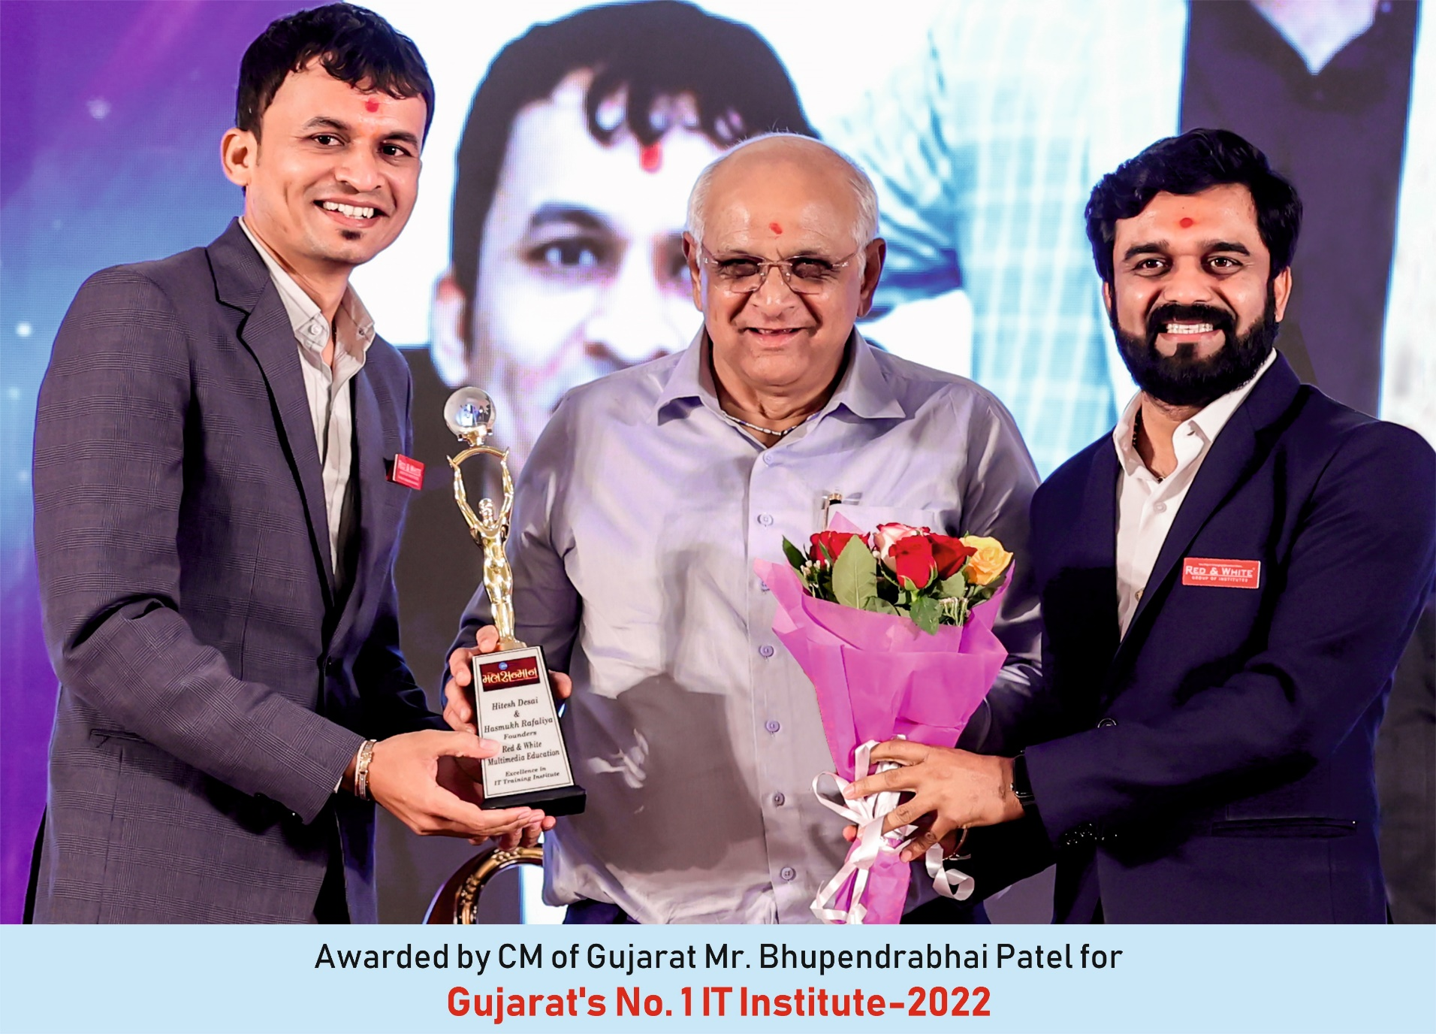

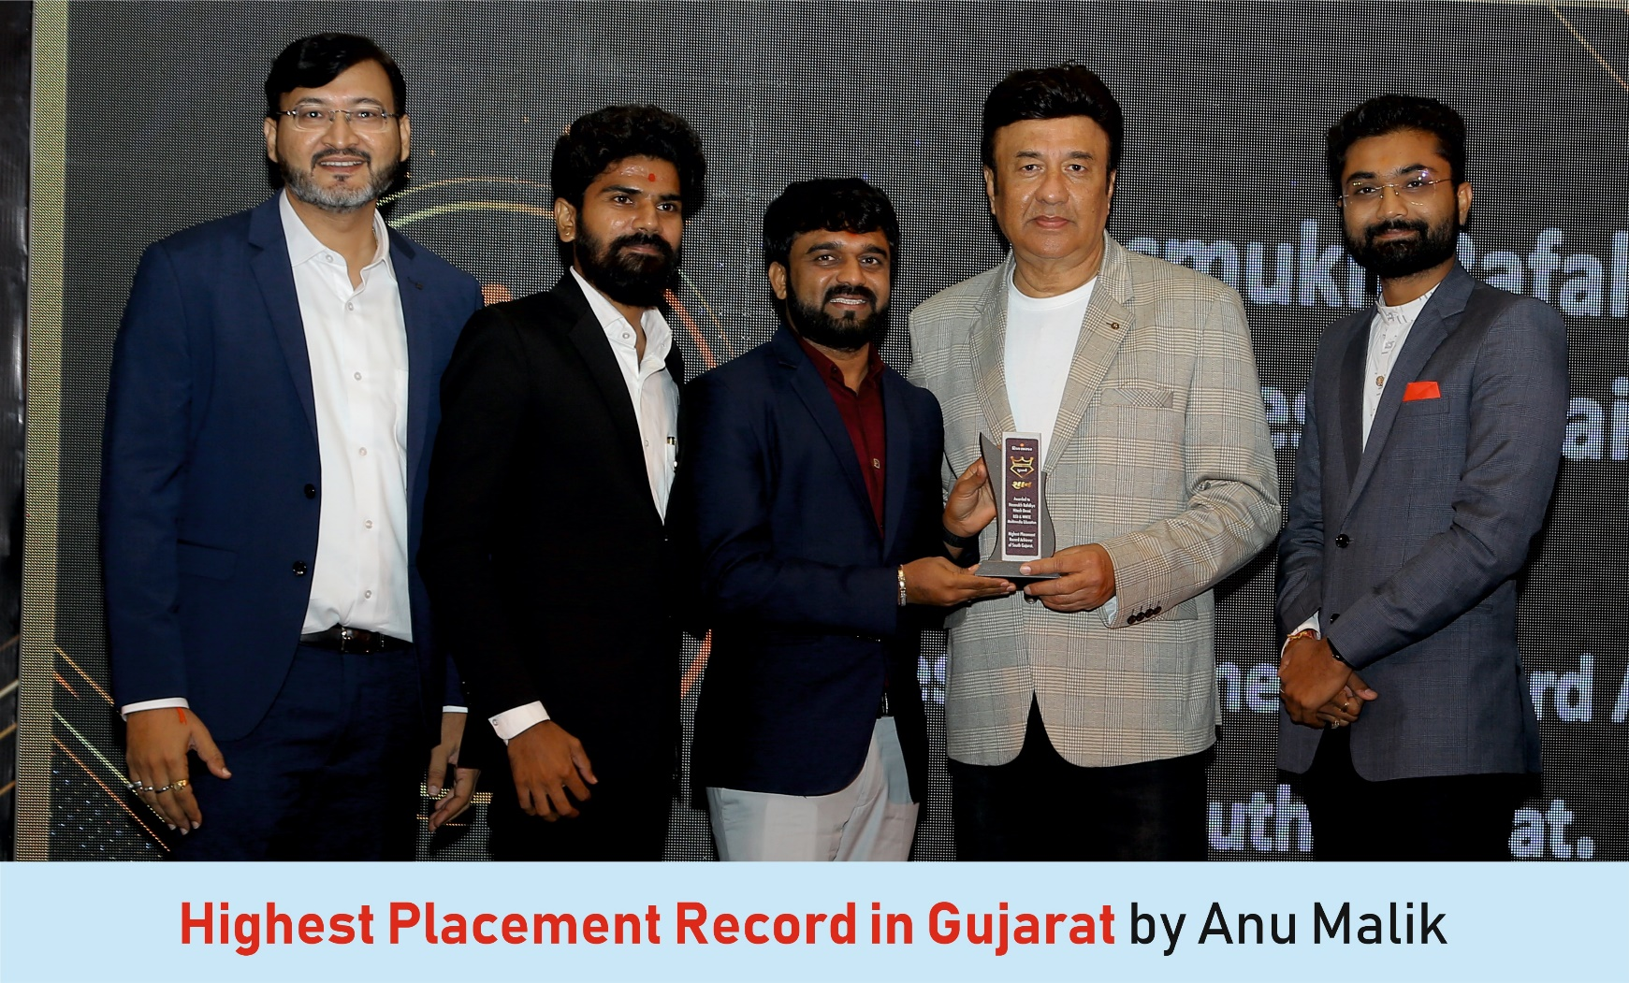
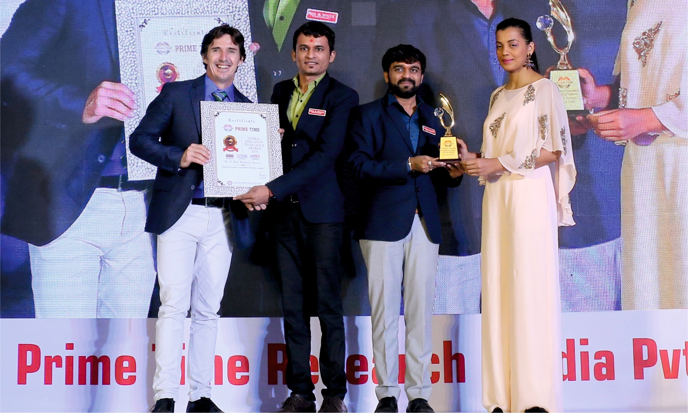
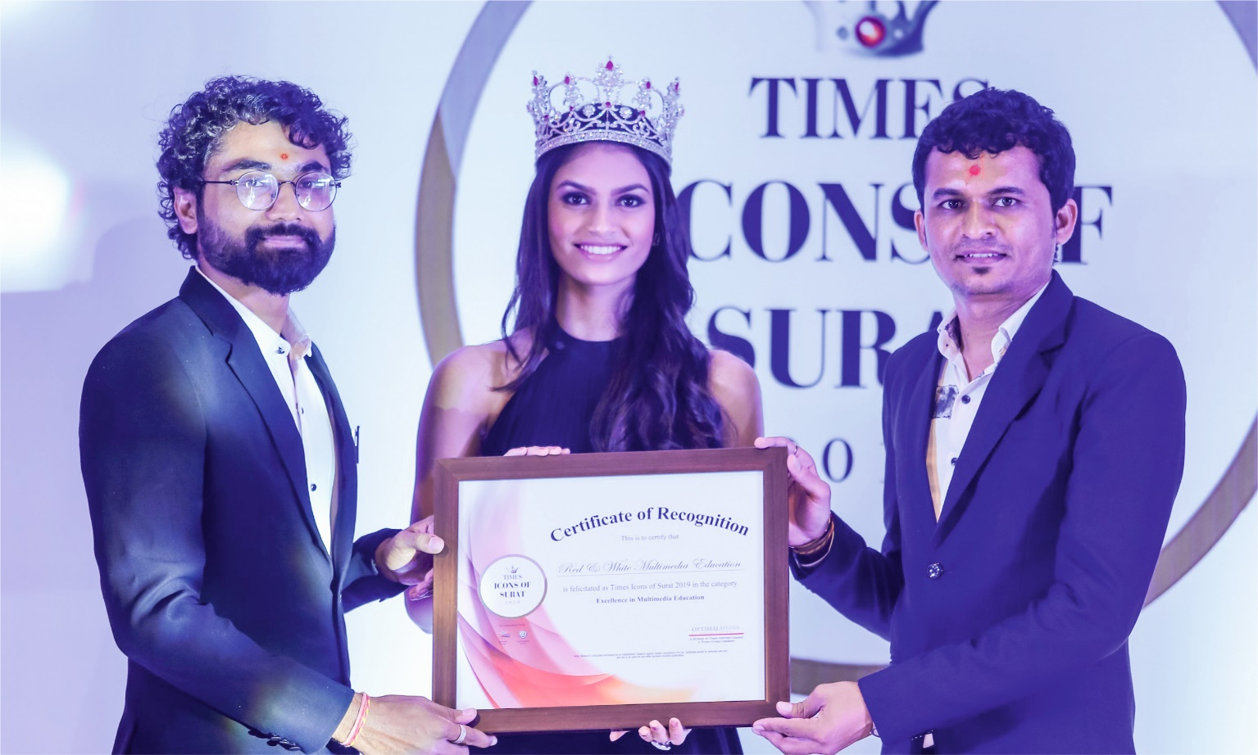

Slide 2

Welcome & Congratulations for being lucky to Get Admission in RNW

Slide 3

Thanks to your Parents also for taking right decision for your Bright Career.

Slide 4
About Red & White Multimedia Education Established in 2008
Vision
To become a globally leading institute in preparing every student for the industry.
Mission
We empower the student to achieve a global career, by providing skills according to their potential through innovative methods.
Core Values (ISIU):
Integrity
Adherence to strong ethical principles, honesty, and fairness in all actions and decisions, creating a foundation of trust.
Student-Centric Focus
Putting students first. Every decision and action is taken to benefit the students, helping them learn and grow.
Innovation
Coming up with new ideas and better ways of doing things. It's about thinking creatively and making improvements.
Unity
Working together as one. Everyone supports each other like a family to achieve common goals.

Slide 5
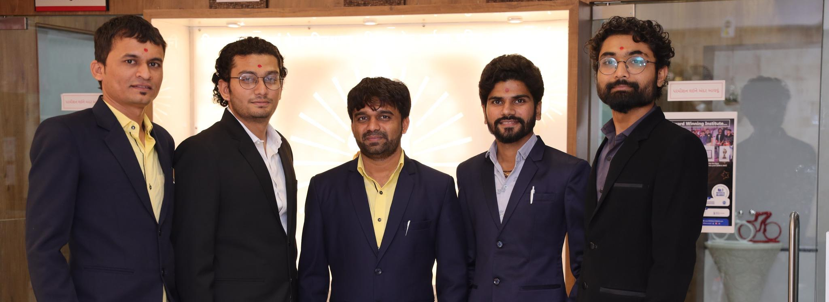
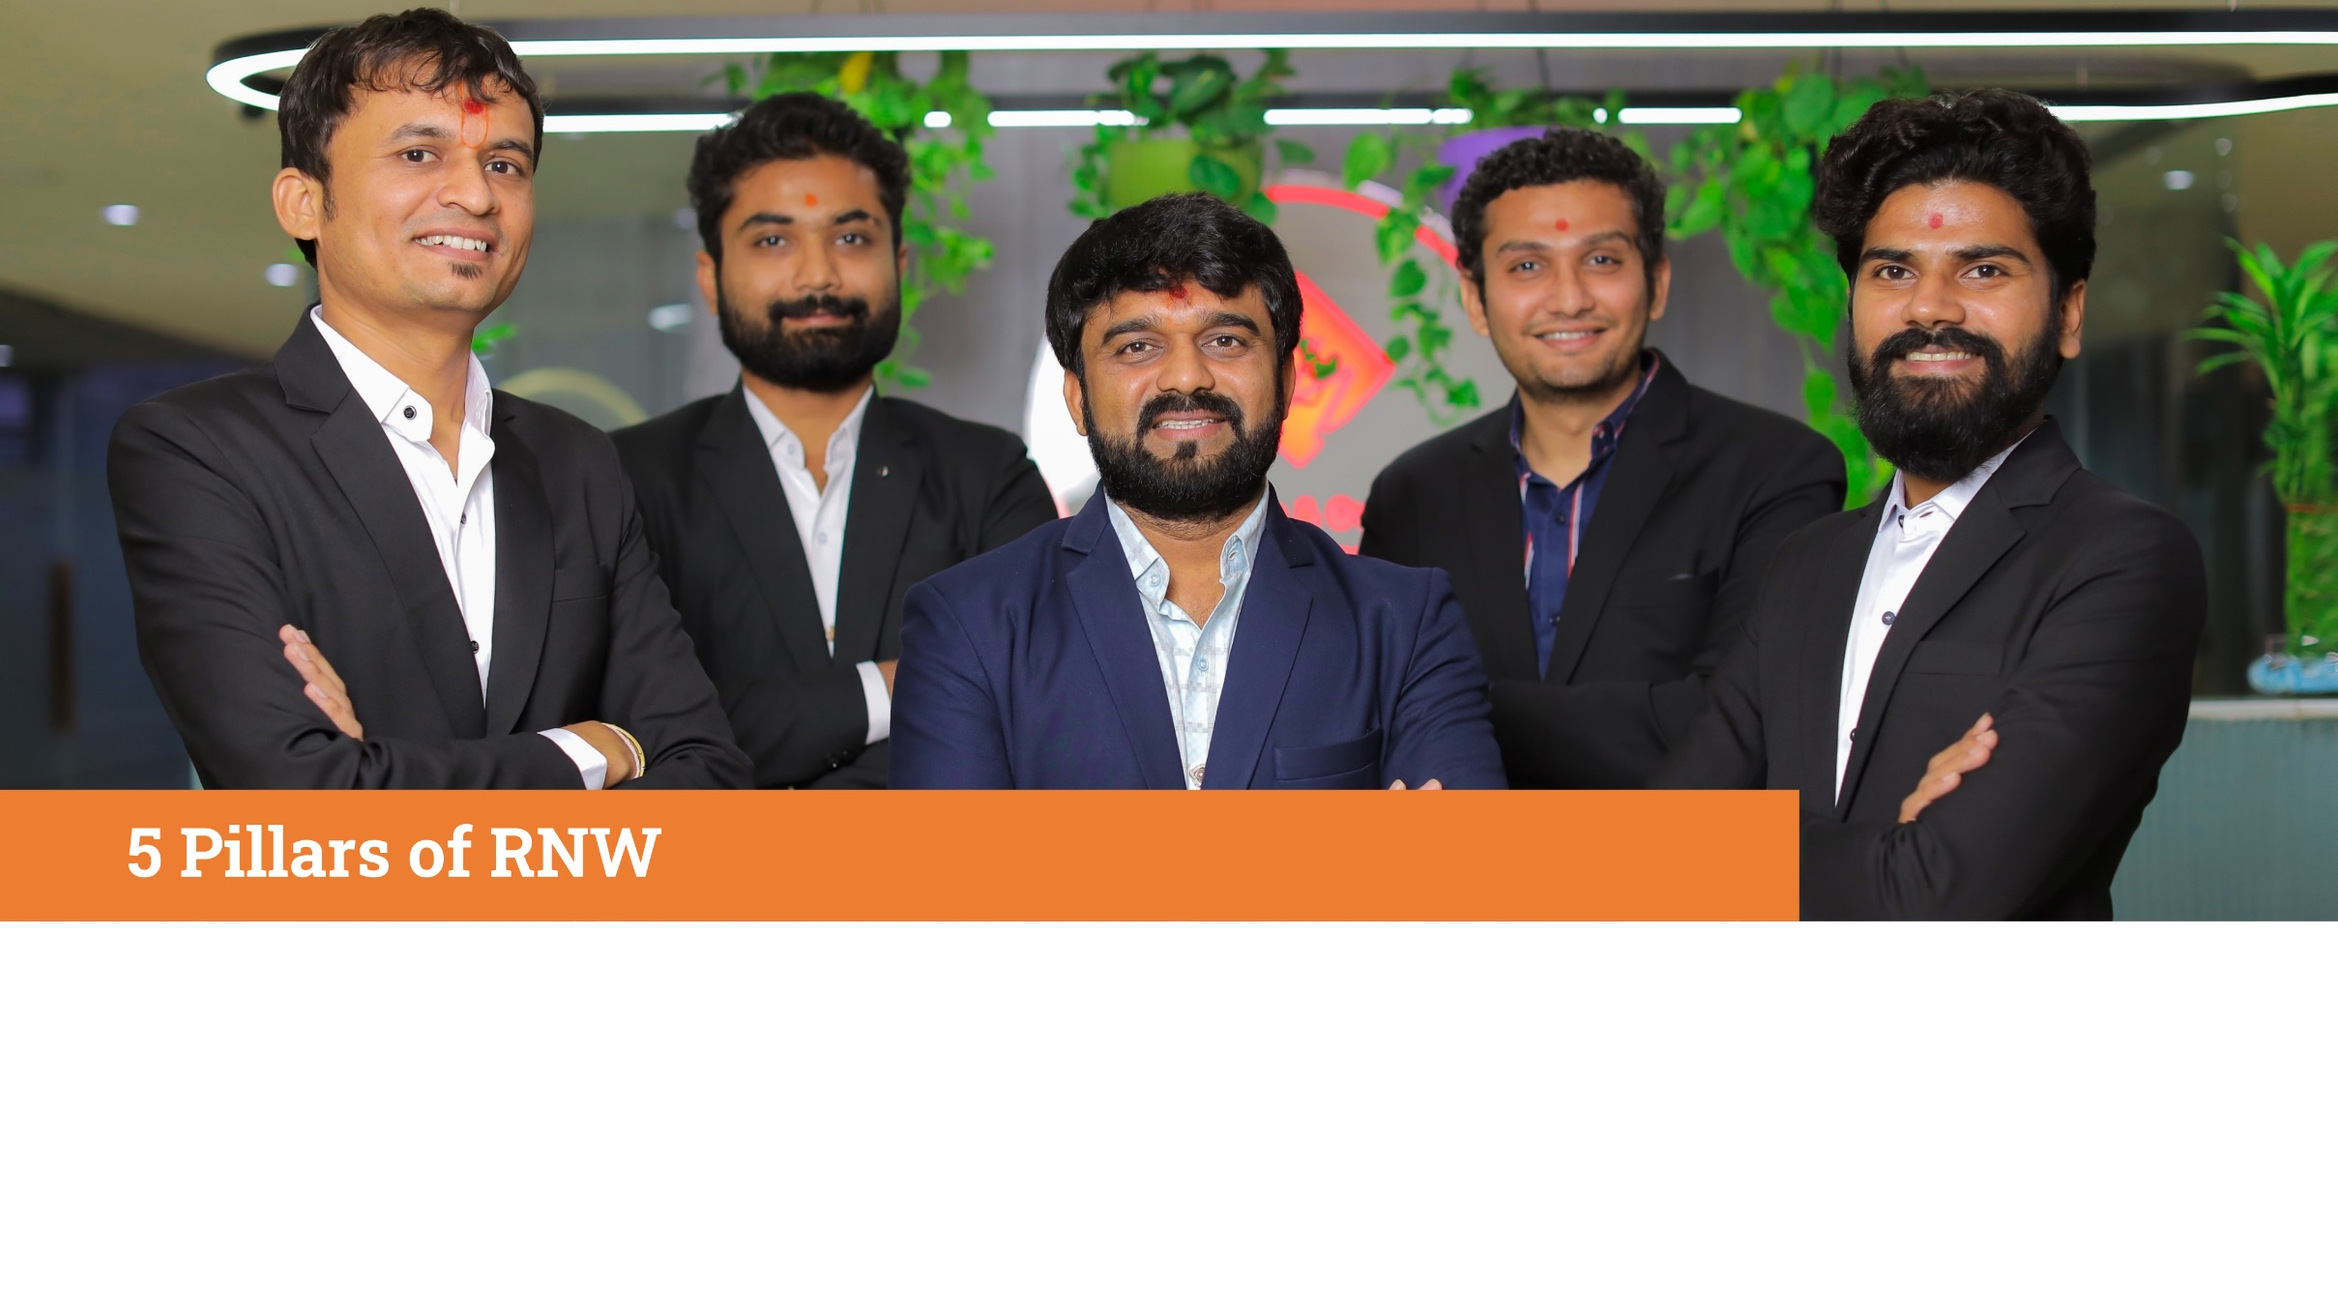
5 Pillars of RNW
Board of Directors
RWn. Hitesh Desai (Founder) RWn. Hasmukh Rafaliya (Founder) RWn. Parth Shiyani RWn. Pradip Malaviya RWn. Mehul Kachhadiya

Slide 6
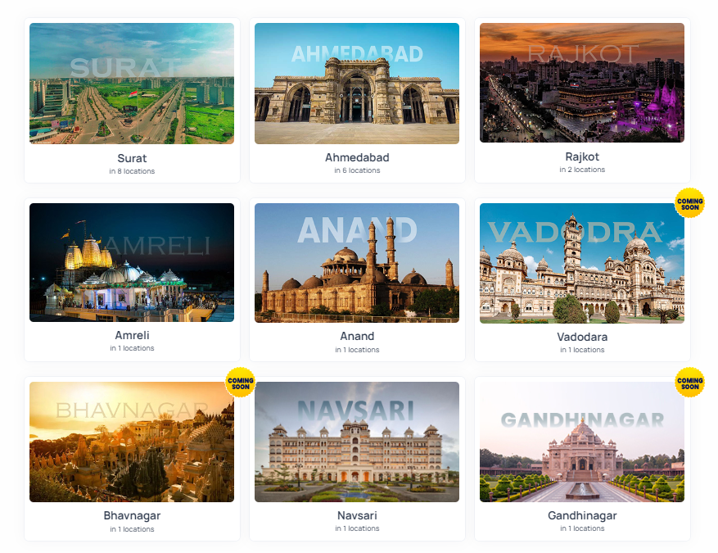
Branches in Gujarat

Slide 7




OUR AUTHORIZATION FOR SKILL & WILL DEVELOPMENT OF STUDENTS.
NSQF
National Skill
Qualification
Framework

Slide 8








Courses Available
Programming
Software Development Foundation
Python
Designing
UI/UX Design
Graphics Design
Web Development
Front-end Development
Back-end Development
Fullstack Development
Application Development
Android
iOS
Flutter
Gaming
Game Design
Game Development
Animation
AI/ML
AR/VR

Slide 9




Skill Identification Module GIM – Graduate in Multimedia
Prototype (Drawing)
Design & Creativity
Imagination or Coding
Logic (Foundation of Programming & Development)

Slide 10



Lecture schedule Note: This schedule is applicable to the GIM course only.
2 Days – Design & Creativity
1 Day – Imagination or Coding
2 Days - Logics

Slide 11
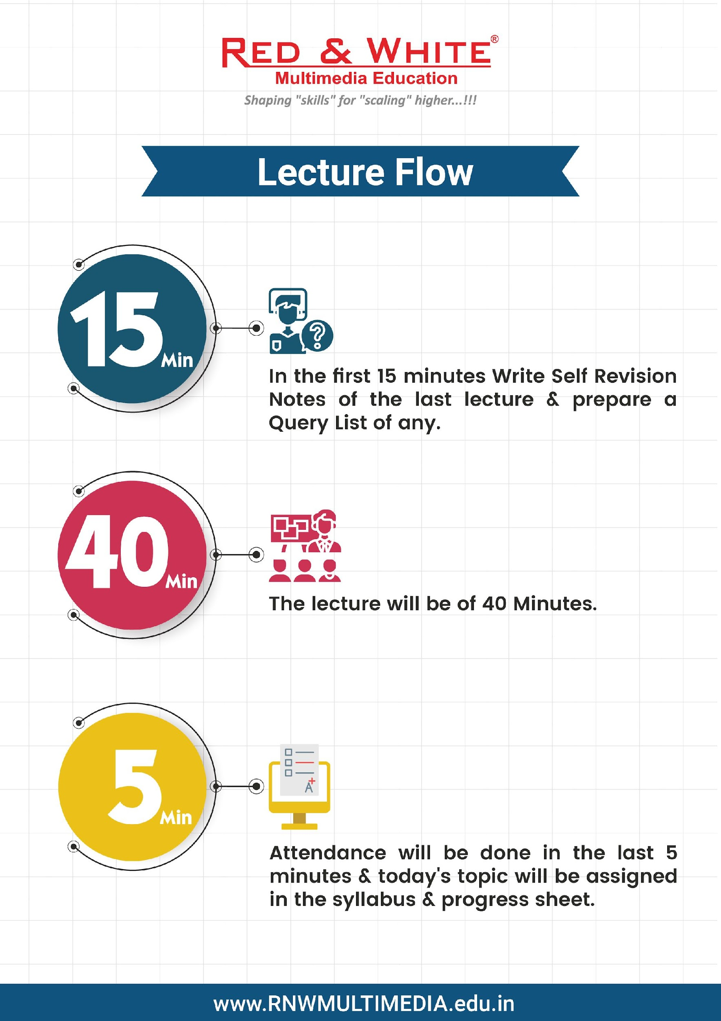
Daily 1Hour Lecture Flow

Slide 12
Pre GIM
100% Job
Project Submission in
Google Classroom
Placement Procedure
GIM/Master
Course
Structure
Certificate Procedure
Examination
Pass Final Examination with 80% Min.
Result
Project Submission with 80% Min.
Conference For
Course Selection
Company Visit &
Expert session
Study Master Course

Slide 13

Weekly schedule
Monday
Wednesday
Friday
Professional Wear(Formal Shirt, Pant, Belt, Socks, In-Shirt)
Professional Wear(Formal Shirt, Pant, Belt, Socks, In-Shirt)
RNW T-Shirt
Professional Wear(Formal Shirt, Pant, Belt, Socks, In-Shirt)
Casual Wear
Casual Wear
(Expert Sessions & Workshops)
Tuesday
Thursday
Saturday

Slide 14

Daily Mantra to Glory…!!!

Slide 15

During The Course
Attendance should be more than 90% anyhow, to attend the examination.
All projects are compulsory to complete and submit.
All examinations, viva, projects etc. should be clear with overall 80% above for the Placement.
To get marks, tasks should be completed 100%.
All 3 rounds (Technical, Practical & HR) conducted after completion of course should be clear with 80% or above for Job Placement.

Slide 16




Student Application types
Leave Application
Extra Time Application
Certificate Application
Job Placement Application

Slide 17



Certificate Procedure
Complete the course
Fill the certificate form from Reception Desk
You will be issued certificate within 15 working days.

Slide 18
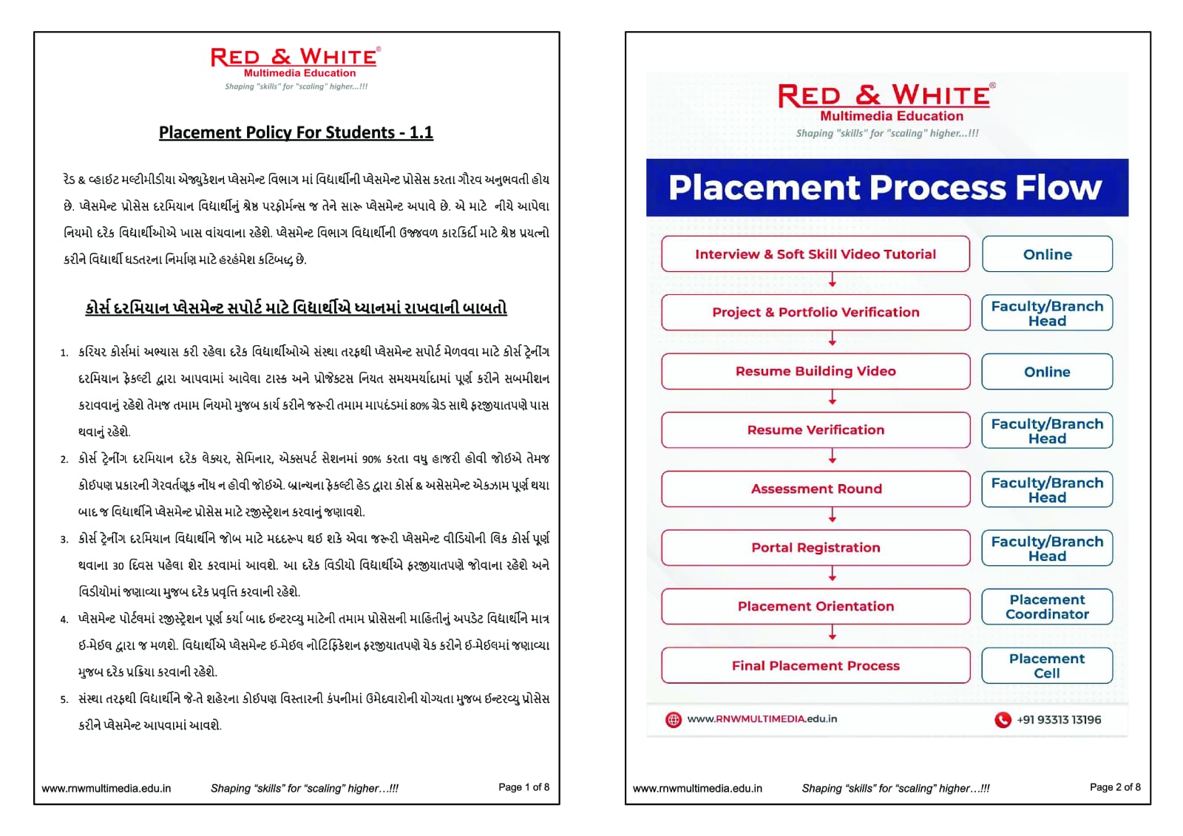
Placement Procedure

Slide 19
Mediums of Further Communication
Register E-mail Address
Messages on registered mobile number
Mobile Student App
WhatsApp
Note:
If your numbers are being changed then inform to admission department.
- Your parent's number should be registered properly. Any wrong data may affect your gov. Approved Certificate.

Slide 20
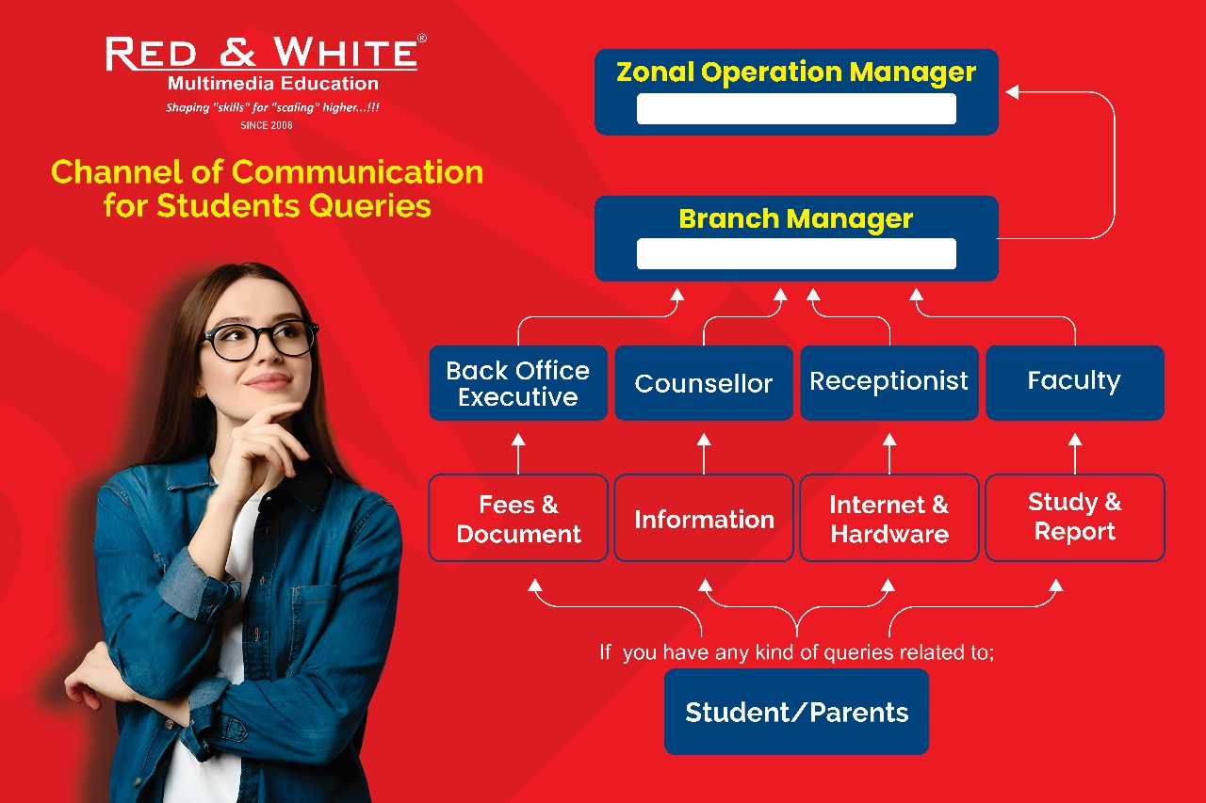
Communication channel for any queries

Slide 21


Stay Away from Gossiping
For any Feedback or Suggestions, scan the given code attached to the exit door of the branch or Contact the Branch Head of your branch.

Slide 22
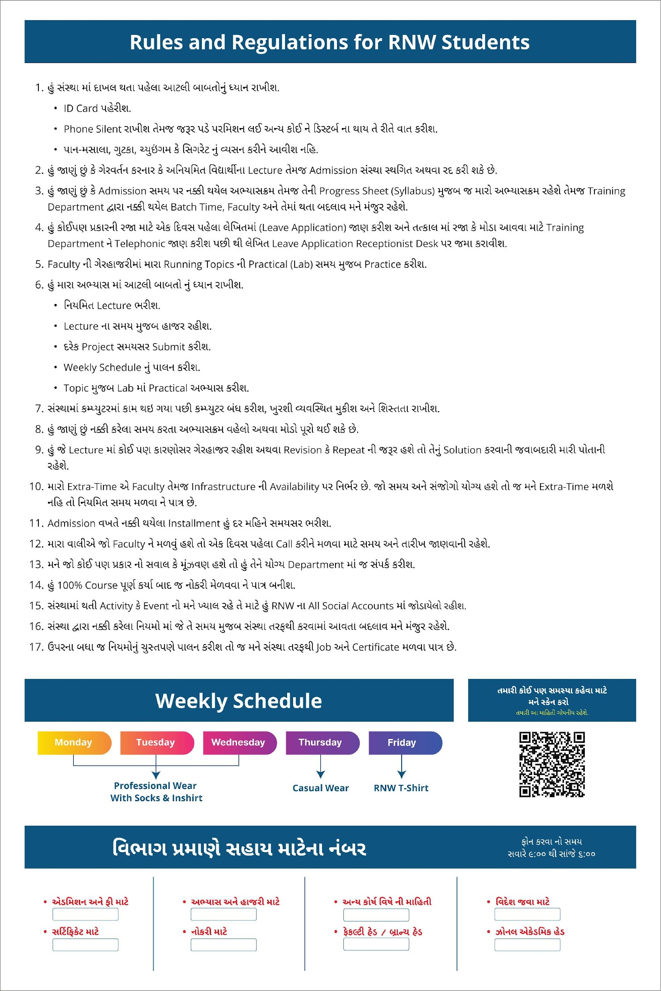




Whom to Call for Any Problems?
You will Find this Post on Noticeboard at your Branch.
Scan Code to say any problem.
This message will be passed directly to the Founder of RNW.
Your Identity will be secured.

Slide 23
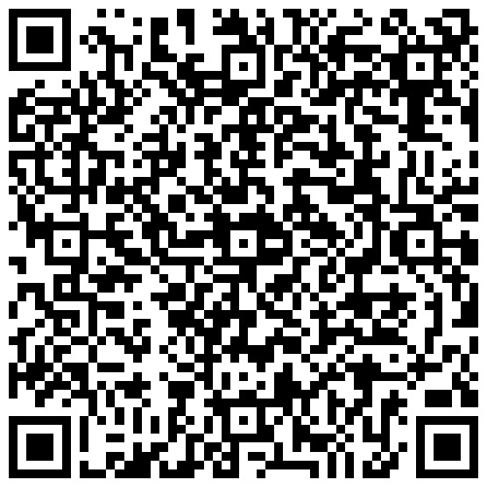
Social Medias
Like & Follow to get any information & stay updated.
Website www.rnwmultimedia.edu.in/
Facebook Red & White Multimedia Education
Instagram rnwmultimedia_official
LinkedIn Red & White Multimedia Education
Twitter Red & White Multimedia Education or @rnw_multimedia
YouTube Red & White Multimedia Education

